Slide 1
Lesson 5 & 6
Python Programming
{
< Let’s start >
}
...

Slide 2
Table of contents
01
02
03
Datatypes
Variables vs Datatypes, definition of datatype
Built-in datatypes
Different built-in python datatypes
Examples
Practice and exploration.

Slide 3
01
Datatypes
{
..
< Datatype defines the kind of information that a variable can hold>
}
..

Slide 4
Variables vs Datatypes
A variable is like a container that holds information. You can think of it as a label or box where we store things for later use. Variables can change their values over time.
Data types define the kind of data that a variable can hold. Just like you can store different types of things in a container in daily life (e.g., you store water in bottles and food in plates), variables in programming store different types of data, such as numbers, text, or true/false values.
}
..

Slide 5
Built-in datatypes in python
*
Numeric datatypes
String
Boolean
Sequences datatypes
Mapping types
Set types
Binary types
None types

Slide 6

Built-in datatypes in python
{
Numeric
String
Integer(int): Whole numbers, both positive and negative, without decimals.
Float: Numbers with decimal points.
Complex: Numbers with real and imaginary parts as a + bj
It is a sequence of characters enclosed in single or double quotes.
}
*

Slide 7


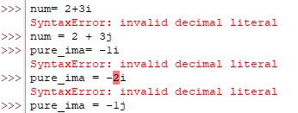
Numeric Examples
...
Integer
Float
Python uses j instead of i as i is use for current
Complex

Slide 8


Built-in datatypes in python
{
None
Boolean
None: represents the absence of a value or a null value in Python.
It is use to represent two values true (1) or false (0).
}
Null or null are both not defined
*

Slide 9
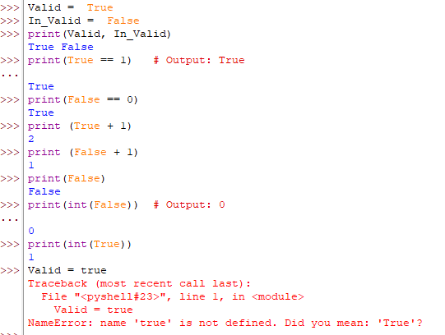
Boolean Examples!
}
*

Slide 10
Sequences Datatype
sequence types are used to store collections of items (values) in an ordered manner. Each element in a sequence has a position or index that starts from 0. Python supports several built-in sequence types, and they differ in terms of mutability (whether you can change their elements) and behavior.
Different kinds:
List
Tuple
Range
*

Slide 11
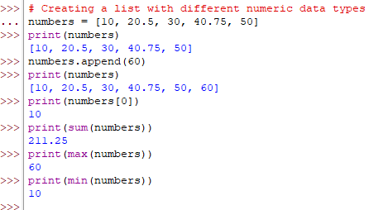
List
{
..
Definition
A list is an ordered collection of data with elements separated by a comma and enclosed within square brackets. Lists are mutable and can be modified after creation.
*
}
..

Slide 12
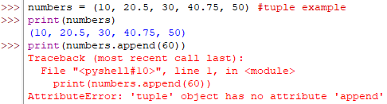

Tuple
{
..
Definition
A tuple is an ordered collection of data with elements separated by a comma and enclosed within round brackets. Tuples are immutable and can not be modified after creation.
*
}
..

Slide 13


Range
{
..
Definition
A range returns a sequence of numbers as specified by the user. If not specified by the user then it starts from 0 by default and increments by 1.
Syntax: range( start, stop, step) → start value is included, stop value is not included and step is the difference between values
*
}
..

Slide 14
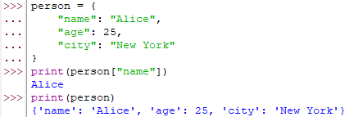

Mapping Datatype
A mapping type like a dictionary holds data in key-value pairs.
Keys must be unique and immutable, while values can be of any data type.
*

Slide 15
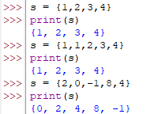

Set Datatype
Set is an unordered collection of elements in which no element is repeated. The elements of sets are separated by a comma and contained within curly braces.
*

Slide 16
Binary Datatype
Binary types are used to store and manipulate data in a raw, binary format
Python has three main binary types:
bytes
bytearray
Memoryview
*

Slide 17
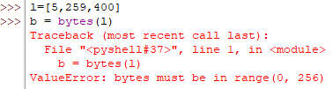

Bytes
{
..
Definition
Each byte is represented by an integer from 0 to 255. Once created, you can't modify it
*
}
..

Slide 18
Practical exercise 01
Create Pakflix , movie streaming website.
Store the 3 titles of the movie using list (string)
Store each movie’s rating as a floating-point number
Use a tuple to store different genres for each movie
Use a set to store the different subscription plans offered by the service.
Use a dictionary to store user information. Each user should have a unique ID (int) as the key and a value that stores their name and email.
Simulate storing a movie trailer using a bytes object.
}
..

